Slide 1
Iota Gamma Directory Conversion Project
60% Report
Working Group 4 Peter Palmisano, Instructor
Sue Argentieri | Luis Sanchez-Artu | Peres Doubeni | Ingrid Henricksen

Slide 2
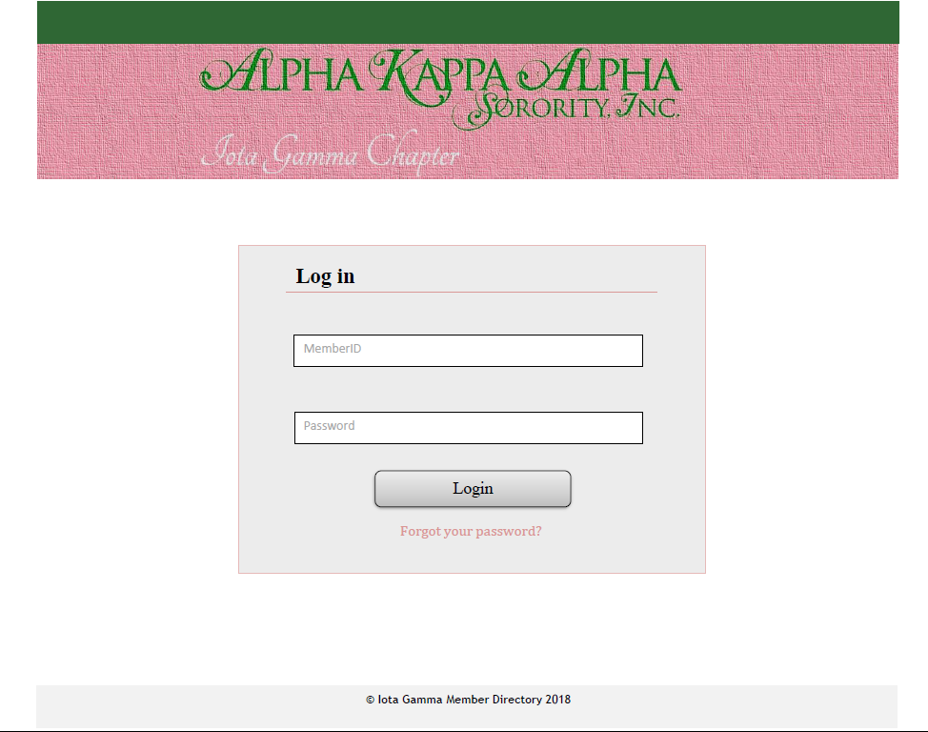
Where we left off:
The Wireframe:

Slide 3
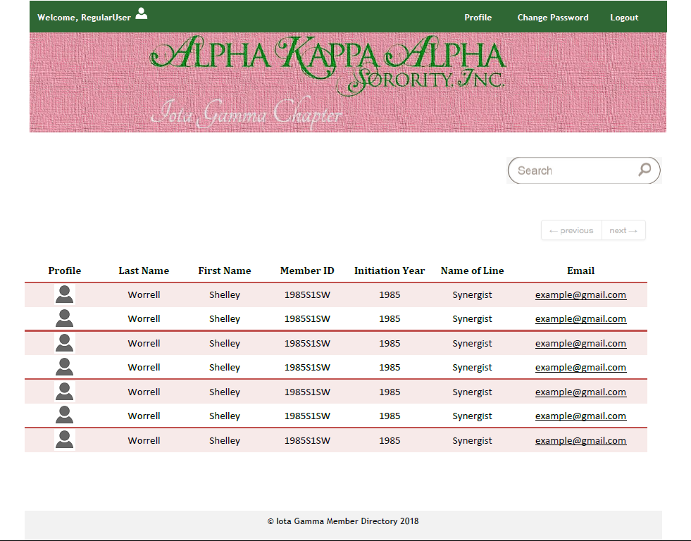
User Has Logged in,
The Wireframe

Slide 4
Where we are now:
Links::

Slide 5
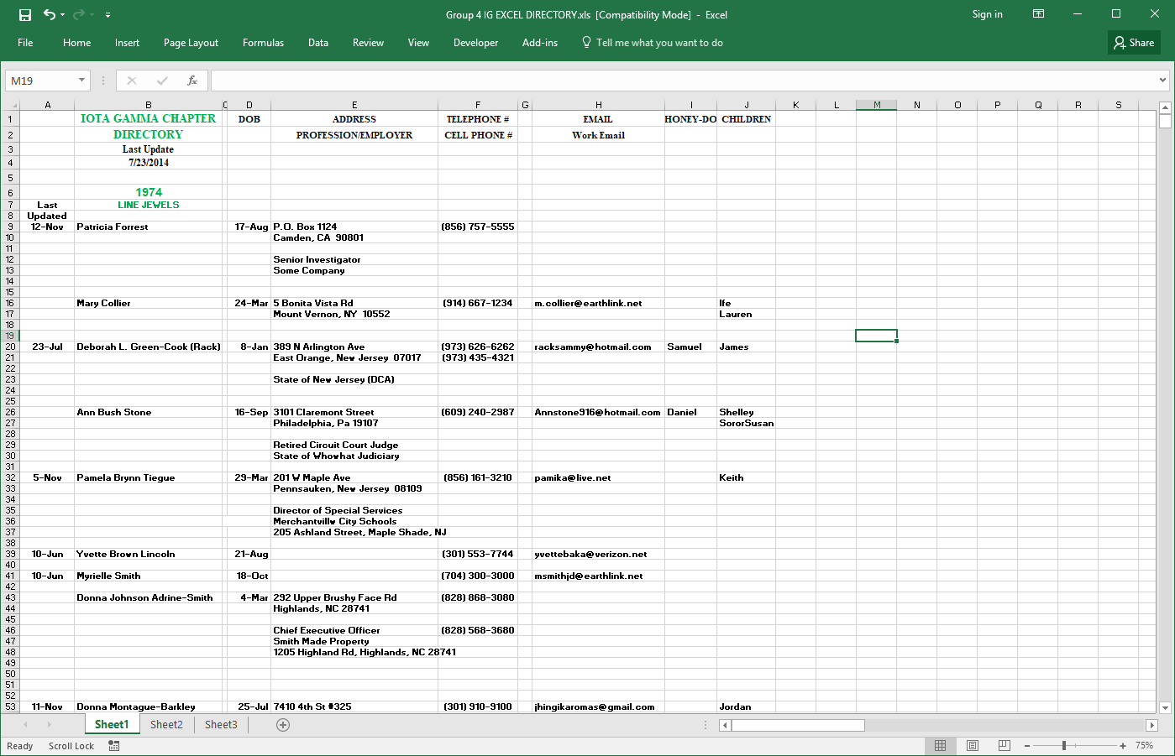
The Data

Slide 6
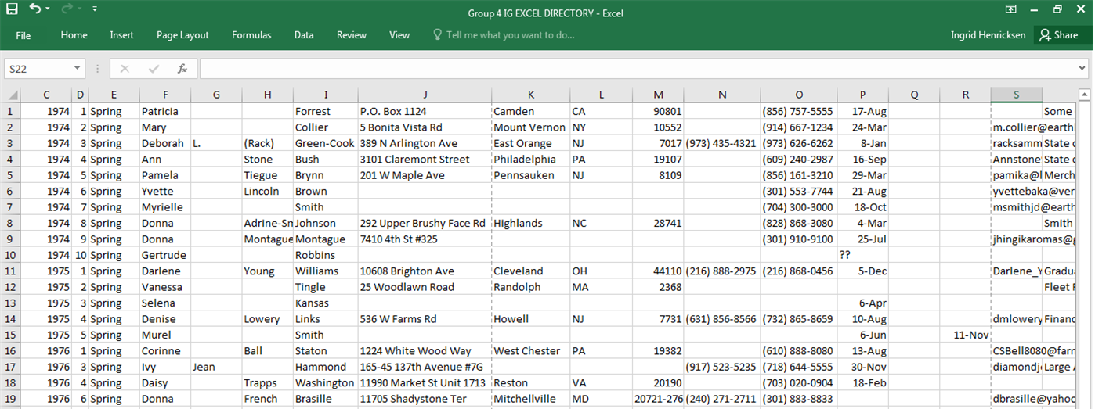
The Data, Ready for use

Slide 7
The Schedule
Target Date | Major Milestones
March 30, 2018 | Business Data Migration & Module Testing Complete
April 14, 2018 | System Launch
April 21, 2018 | Documentation Complete
April 27, 2018 | Project Closure
May 11 | GRADUATION

Slide 8
Potential Risks
Debugging might take more time than anticipated

